Slide 1
Data Augmentation
BY - Aneesh Kabra-2021A7PS0442P
Jainam Shah-2019A7PS0096P
Tanmay Parab-2019A7PS0044P

Slide 2
Overview
While studying about the usage of Artificial Intelligence in healthcare, we came across limited data availability for research being a major limitation in disease diagnosis and prediction. This severely limits the quality of models we are able to produce and for this reason, we decided to try and find a solution to the problem.
Hence, our project is based on data augmentation i.e. to try and use different techniques to expand our datasets artificially without losing its resemblance. In this project, we use Generative Adversarial Networks (GANs) for data augmentation and models such as Support Vector Machines (SVM), K-Neighbours Classifiers, and Random Forest Classifiers to diagnose and predict the possibility of occurrence of heart diseases in the patient.

Slide 3
Background
Data Augmentation is a commonly used technique for increase the size and diversity of the datasets by creating new examples of data which are essentially variations of the original data while still having the same characteristics as that of the original data. With more data, we can train our models better which helps us improve their accuracy.
Generative Adversarial Networks (GANs) is a machine learning model which helps us solve the issue above by generating datasets which are similar to the original datasets. It comprises of 2 neural networks, a generator and a discriminator which are trained together. This is called as adversarial training.

Slide 4
Problem Statement-
Finding a solution to the problem of insufficient medical data
Data Augmentation was chosen for this purpose as it is an extensively used method in AI when we have a shortage of data. We took the responsibility of using the same method on medical data to help increase the number of datasets we have.
We found an admissible tabular dataset on Kaggle for us to use as a base to help create new datasets. Generative Adversarial Networks (GANs) was an optimal choice for the expansion of datasets.
To check the quality of the augmented datasets, we compared the performance metrics of various AI prediction models being currently used (SVM, Random Forest Classifiers etc.) trained on the original + augmented datasets for a particular disease.

Slide 5
Implementation-
Creating the Datasets
The goal for us was to create more data for our models. Therefore, we decided to create 2 new datasets. The entire dataset was divided into 3 parts based on the variable -’race’. The classifications made were - Caucasian, Hispanic and Black.
The 1st dataset made for each part was made by simply running the GAN model over the entire dataset. This created another dataset with similar characteristics but but had a greater diversity since the artificial data points generated had a balance of both positives and negatives.
The 2nd dataset was made by only giving data of people who already had some form of heart disease to the GAN model. This resulted in the artificial dataset to be less skewed in favor of the majority of people having no heart disease.

Slide 6
Testing the new datasets
To check the performance of the 2 new artificial datasets, we chose 2 different prediction models - K-Neighbours Classifier, Support Vector Machine & Random Forest Classifier.
All 3 models were trained on the original dataset for comparing the results after testing the models on the new datasets. For testing, each of the three models were tested on all 3 datasets creating a total of nine output files with the prediction of heart disease incorporated.
The metrics of each model were kept constant for all three datasets to ensure unbiased comparison.

Slide 7
About the Dataset
We used kaggle to select our original dataset. The prediction variable is the possibility of existence of any number or type of heart disease in a person. This medical dataset was obtained by a survey conducted by CDC in the USA. In the survey, questions like - “Do you have serious difficulty walking or climbing stairs?” or “Have you smoked at least 100 cigarettes in your entire life?”
However, it was also noticed that a lot of the variables in the dataset were irrelevant towards predicting heart diseases and therefore, the original dataset of 300 variables was reduced to around 20 variables. The variable “HeartDisease” was treated as binary.

Slide 8
Libraries
Pandas
Numpy
Matplotlib
Seaborn
Scikit Learn
TensorFlow
Keras

Slide 9
Results & Analysis
A total of nine output files were created with the final predicted binary variable - “HeartDisease”. For each of the prediction file data, we calculated the performance metrics of - Accuracy, F1 Score, Precision, Recall, Rand Score and Mean Absolute Error.
Accuracy and Rand Score were similar for the first 2 datasets but a slight dip was noticed in the 3rd dataset/2nd artificial dataset. Mean Absolute Error for the 3rd dataset was atleast equal or higher to the other 2 dataset. This was expected because the third dataset had a higher proportion of the positive cases.

Slide 10
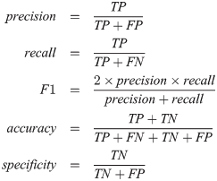
Results & Analysis
Precision was highest for the original dataset and lowest for the 2nd artificial dataset. Despite that, the recall scores remained much higher for the augmented datasets than the original dataset, which led to a significant jump in the F1 Score.

Slide 11
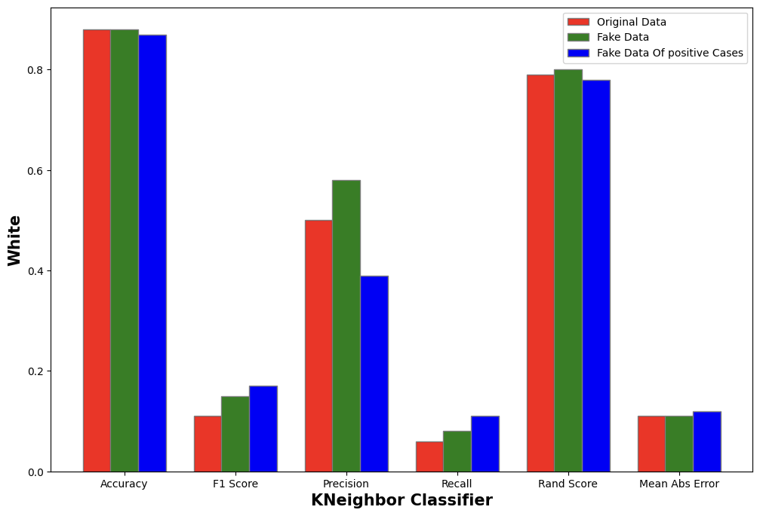
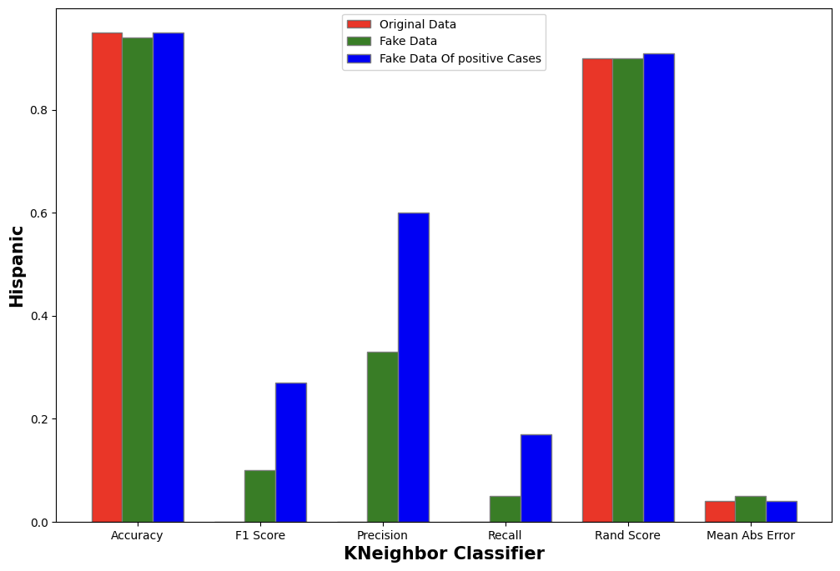
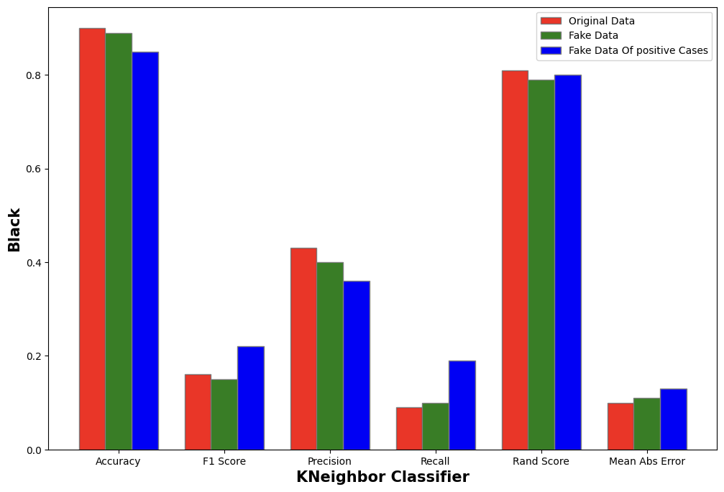
K-Neighbour Classifier

Slide 12
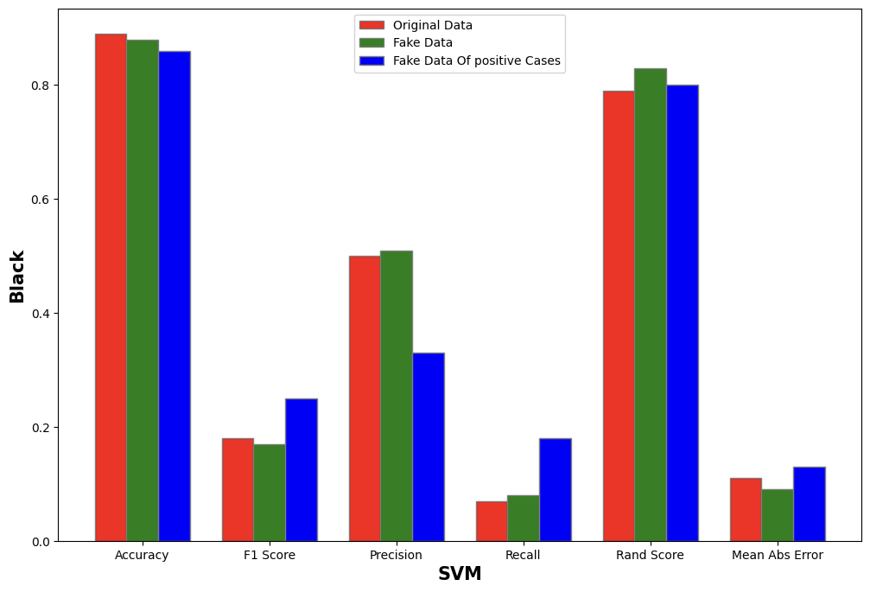
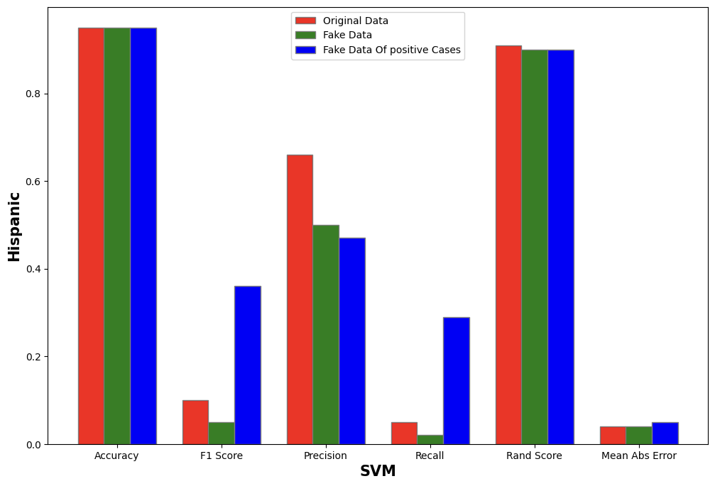
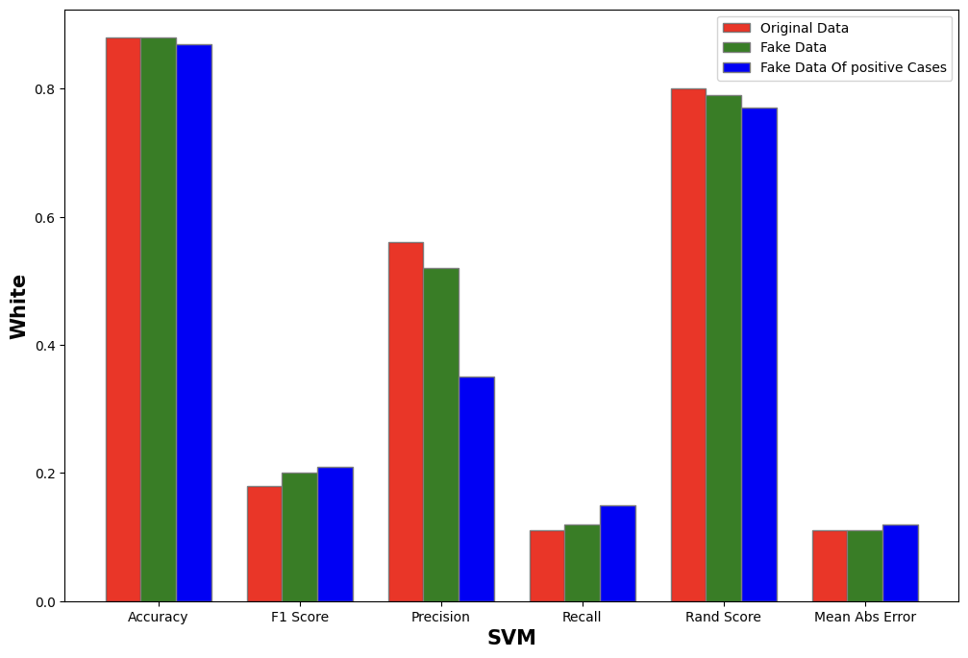
Support Vector Machine

Slide 13
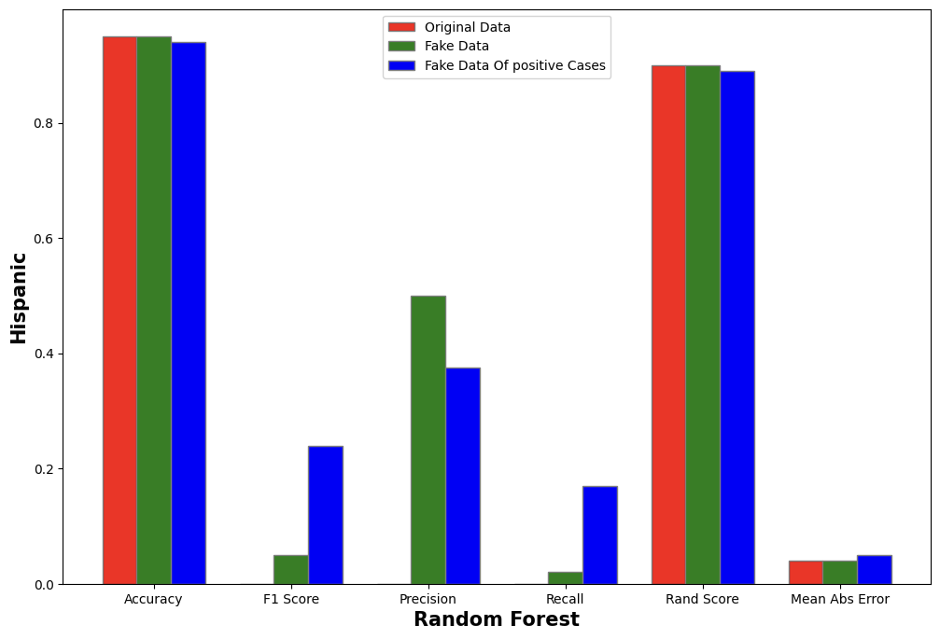
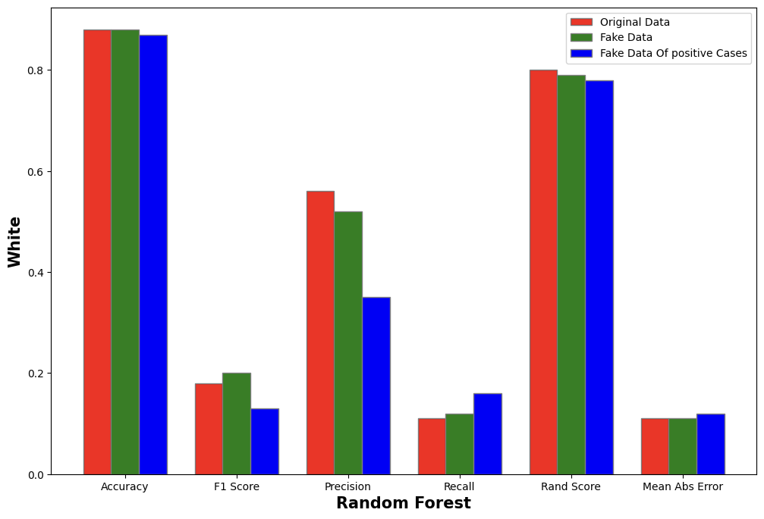

Random Forest

Slide 14
Conclusion
High Recall Score is an important performance indicator in disease prediction models as it measures the ability to correctly identify all individuals with the disease. High recall reduces the risk of false negative predictions which can have serious consequences.
On the other hand, false positive predictions are less harmful as compared to false negative predictions. This makes high recall score very important for our models. Through our assignment, we were able to create such augmented datasets which led to a high recall score. Early prediction of diseases can result in better treatment and a higher chance of surviving the disease which is ensured through a high recall score. While other parameters like accuracy and precision are also important, recall score is a critical measure.

